Slide 1
System Response
The output response of a system is the sum of two responses: the forced response and the natural response
Poles of a Transfer Function
The poles of a transfer function are the values of the Laplace transform variable, s, that cause the transfer function to become infinite
Zeros of a Transfer Function
The zeros of a transfer function are (1) the values of the Laplace transform variable, s, that cause the transfer function to become zero

Slide 2
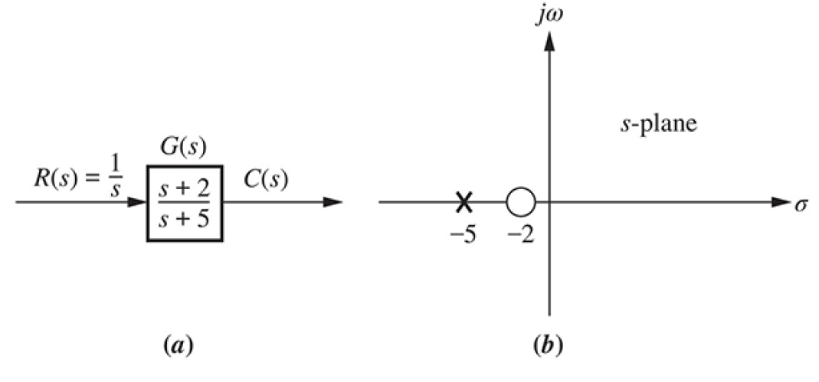
Poles and Zeros of a First-Order System

Slide 3
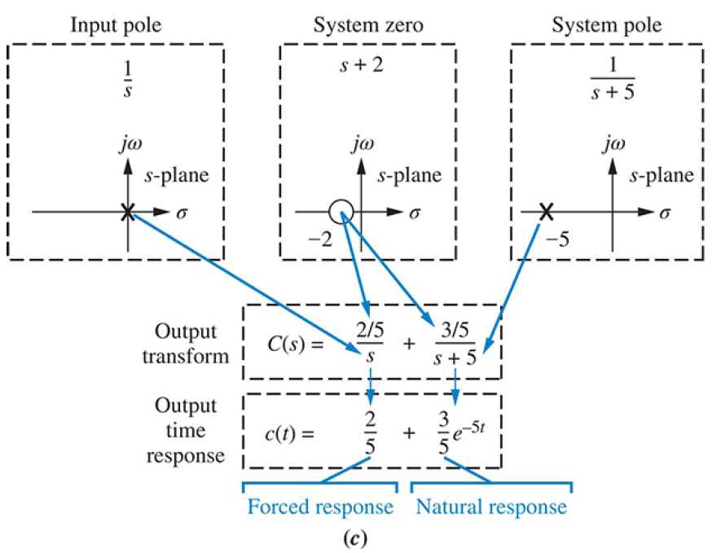

Slide 4
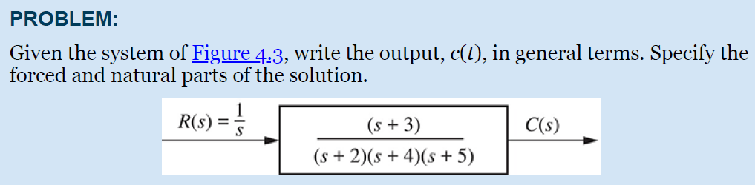
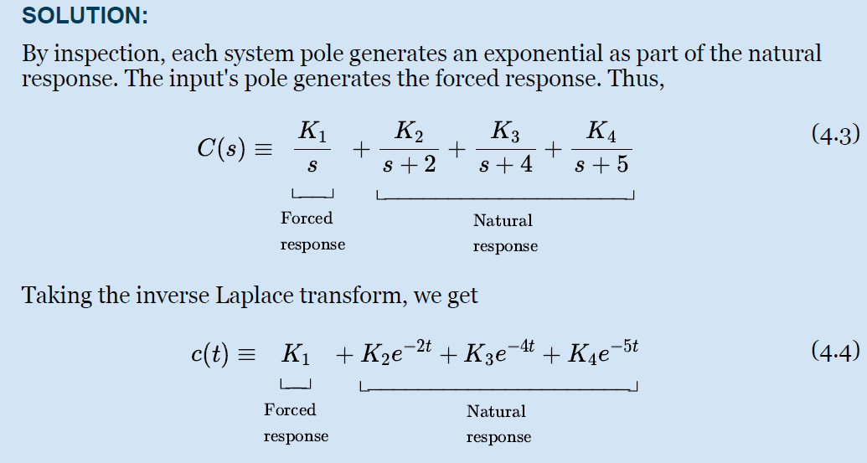

Slide 5

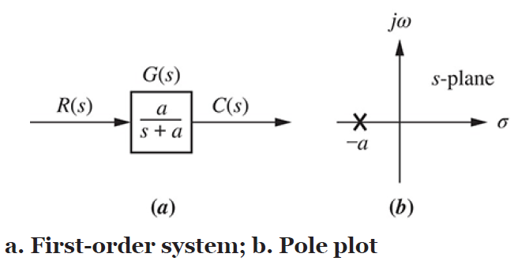
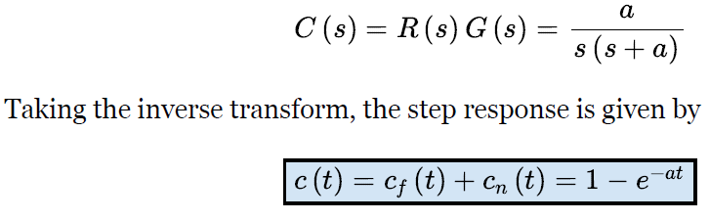

Slide 6
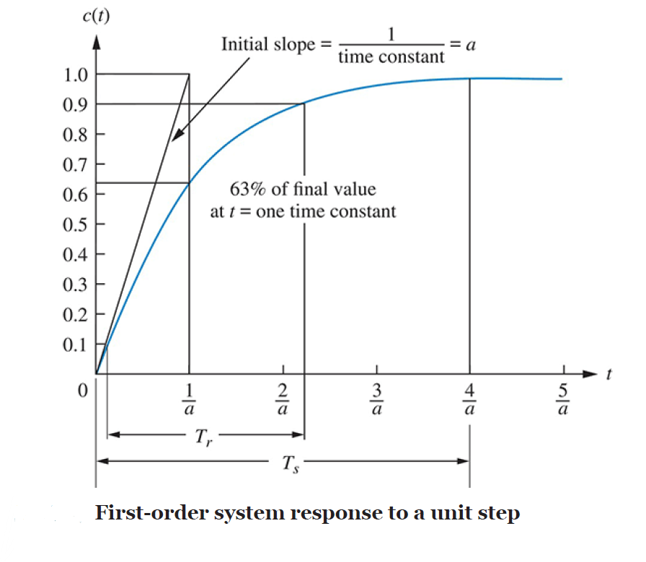

Slide 7
Time Constant
We call 1/a the time constant of the response. The time constant can be described as the time for e−at to decay to 37% of its initial value.
Alternately, the time constant is the time it takes for the step response to rise to 63% of its final value.

Slide 8


Transient Response Specifications
Rise Time, Tr
Rise time is defined as the time for the waveform to go from 0.1 to 0.9 of its final value.
Rise time is found by solving above Eq. for the difference in time at c (t) = 0.9 and c (t) = 0.1. Hence,

Slide 9

Settling Time, Ts
Settling time is defined as the time for the response to reach, and stay within, 2% of its final value.
Letting c (t) = 0.98 in above Eq. and solving for time, t, we find the settling time to be

Slide 10
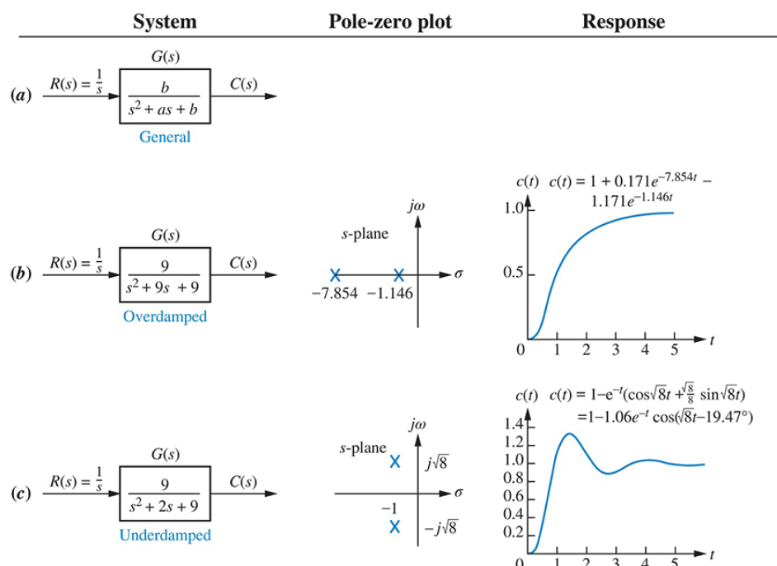
Second-Order Systems

Slide 11
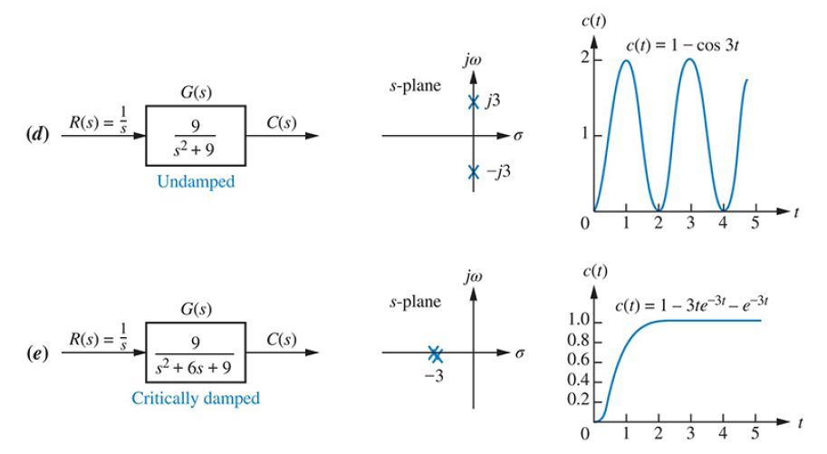

Slide 12
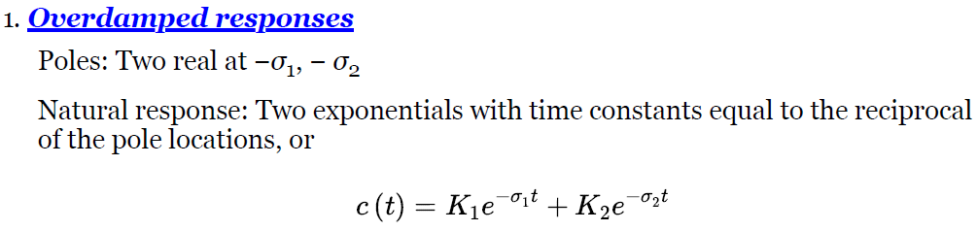
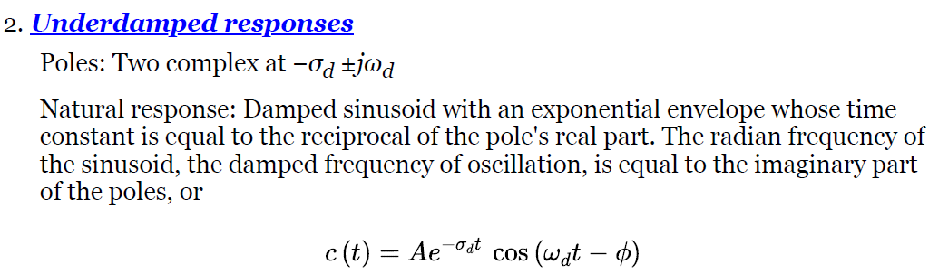

Slide 13
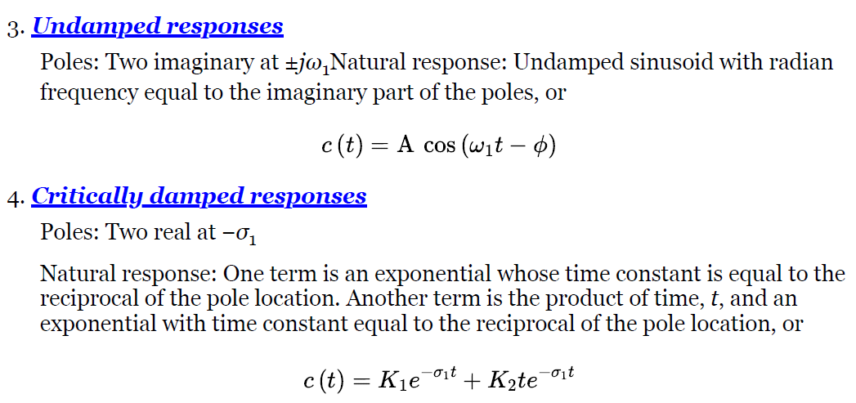

Slide 14
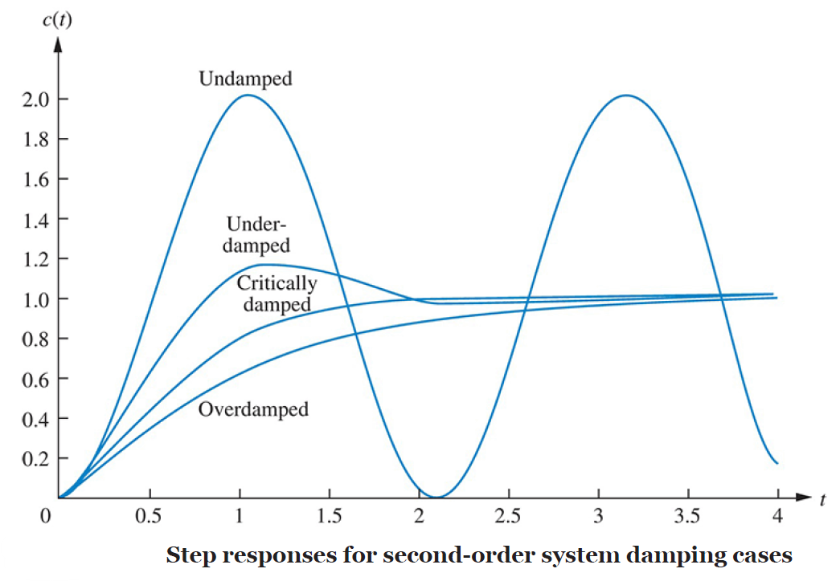

Slide 15

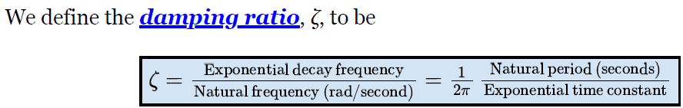
The General Second-Order System
Natural Frequency, ωn
The natural frequency of a second-order system is the frequency of oscillation of the system without damping. For example, the frequency of oscillation of a series RLC circuit with the resistance shorted would be the natural frequency.
Damping Ratio is one that compares the exponential decay frequency of the envelope to the natural frequency

Slide 16
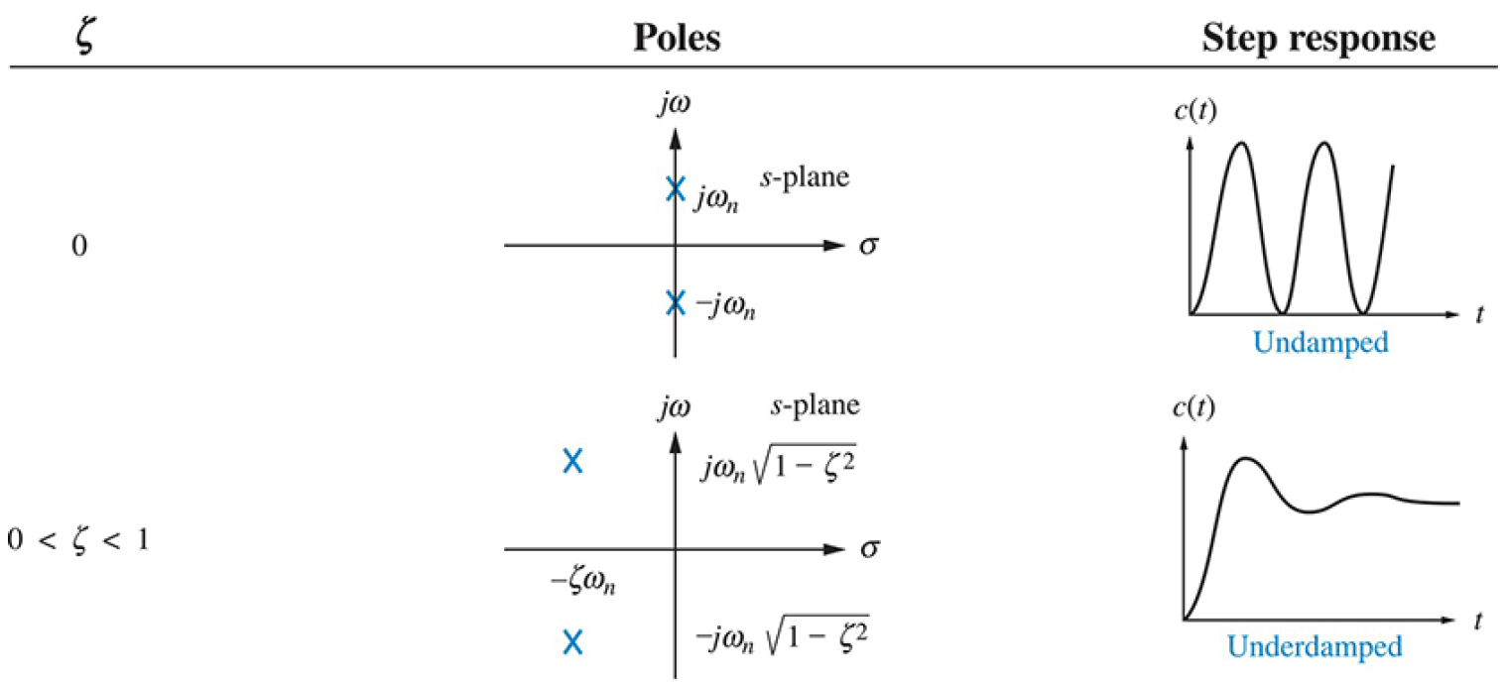

Slide 17
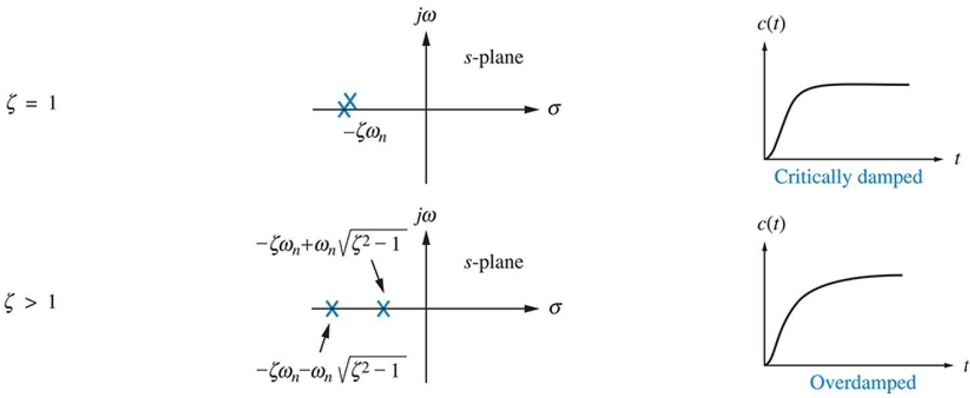

Slide 18
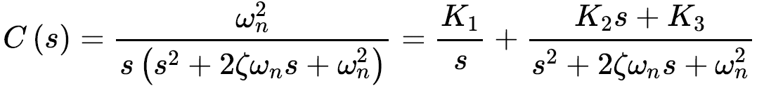
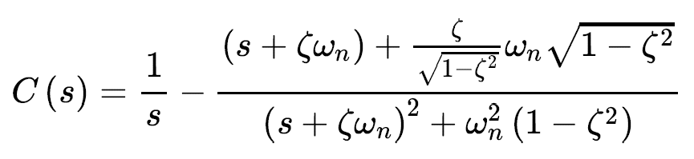
Underdamped Second-Order Systems
The transform of the response, C(s), is the transform of the input times the transfer function,

Slide 19
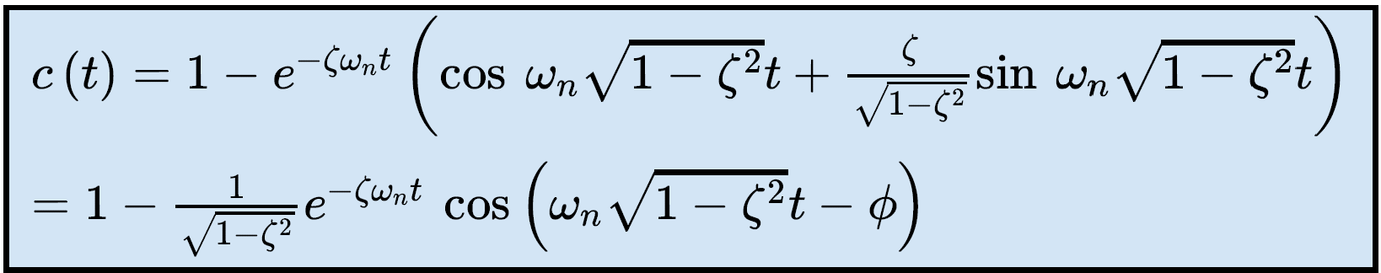
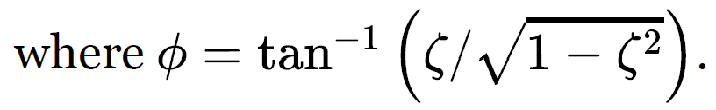
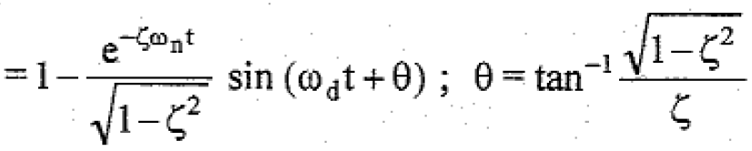


Slide 20
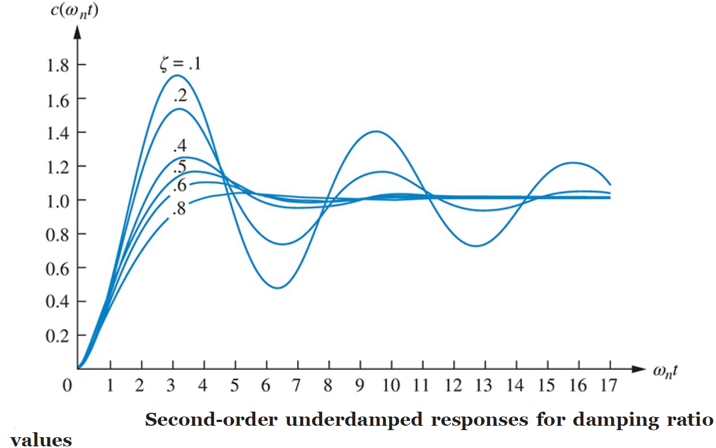
The lower the value of ζ, the more oscillatory the response.

Slide 21
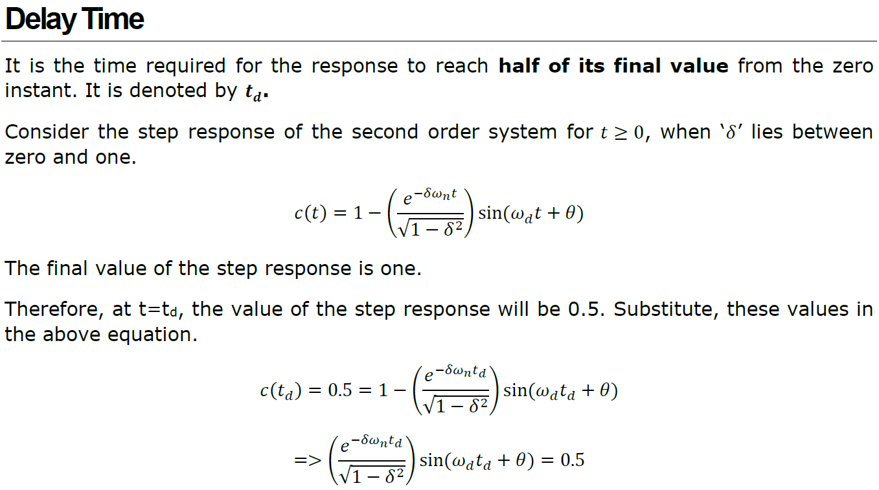
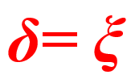
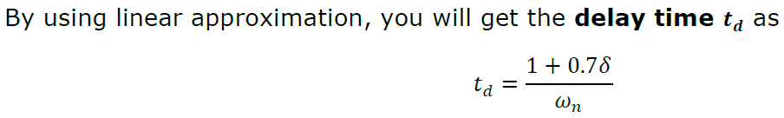

Slide 22
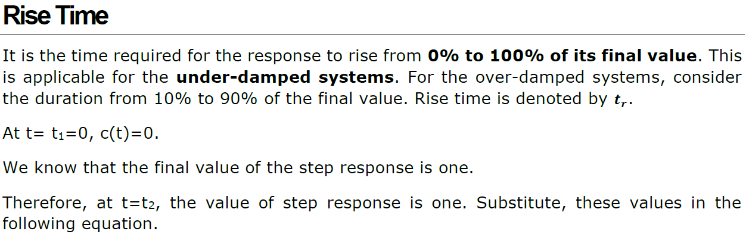


Slide 23
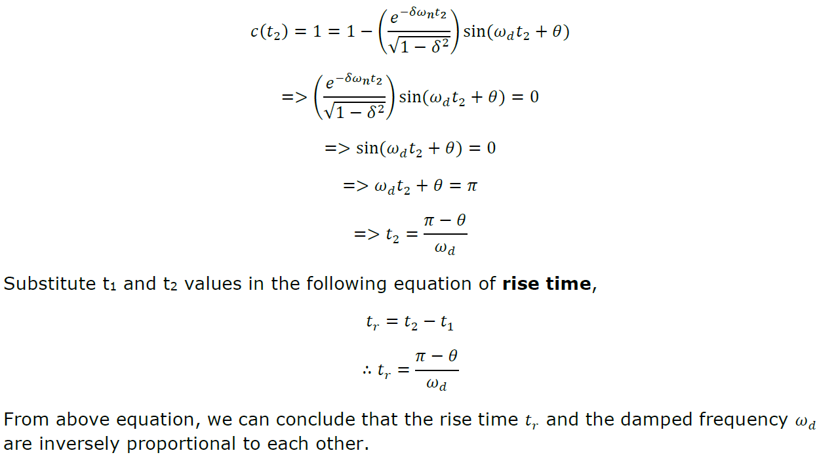

Slide 24
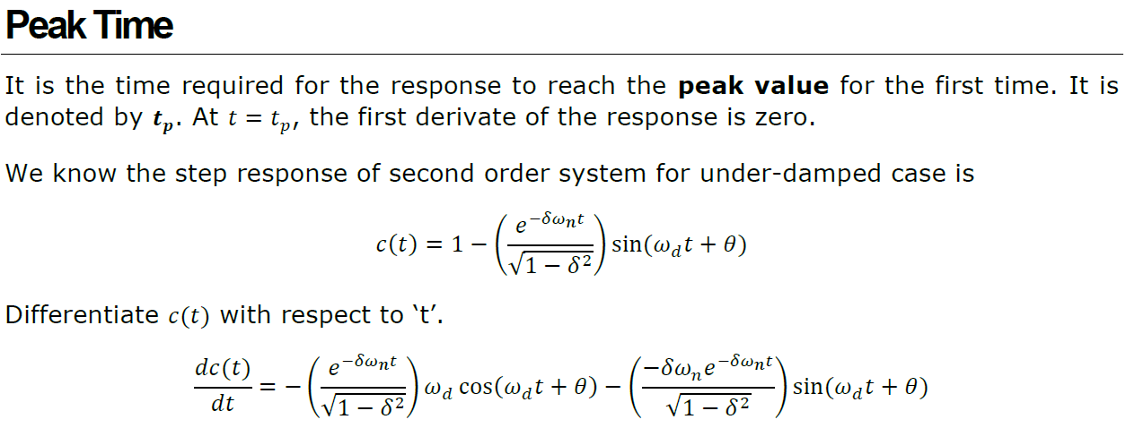

Slide 25
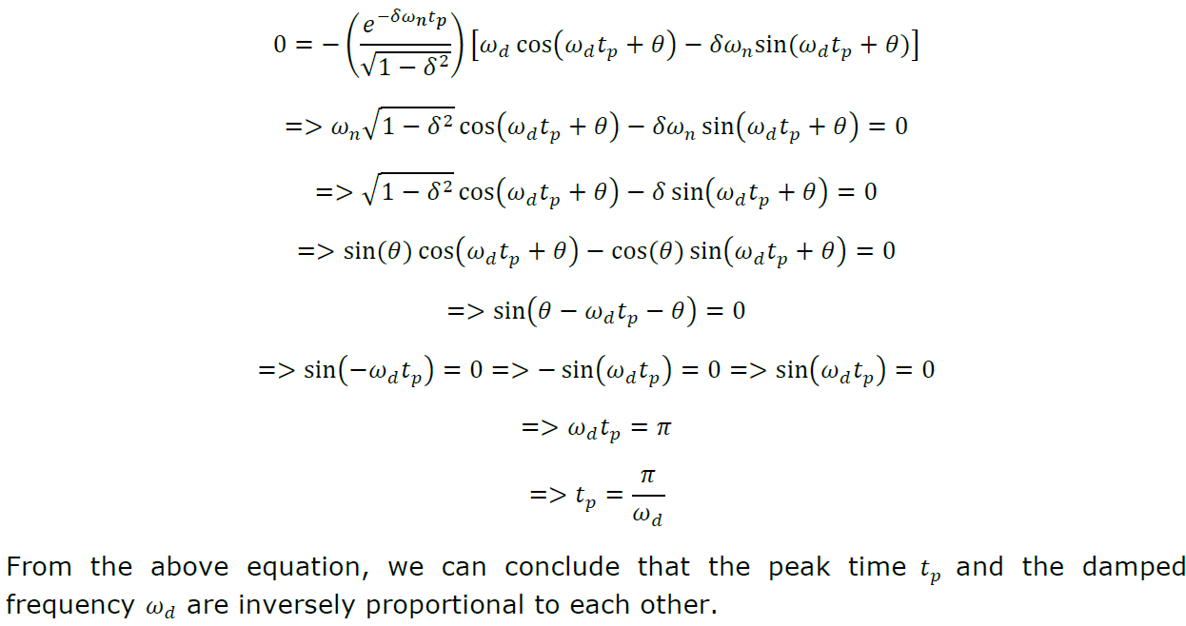

Slide 26
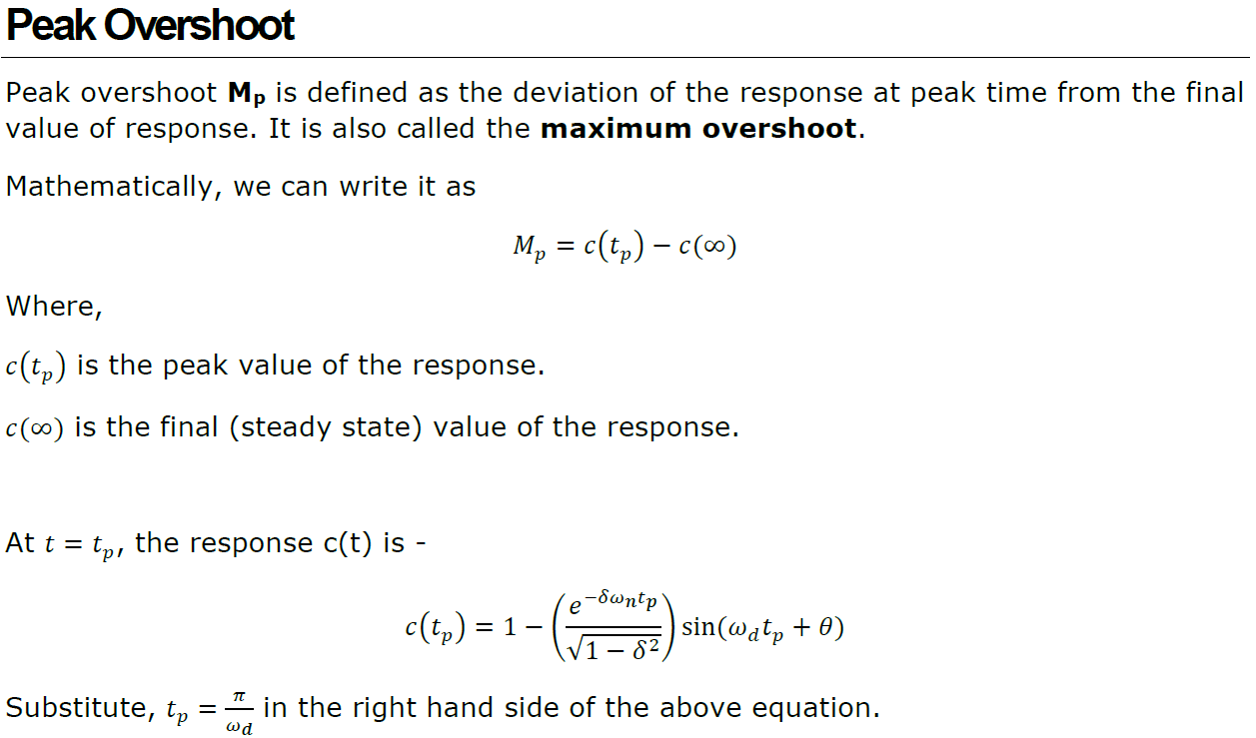

Slide 27
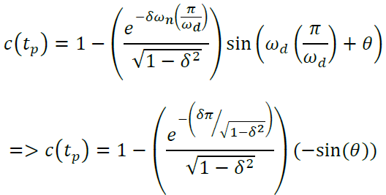
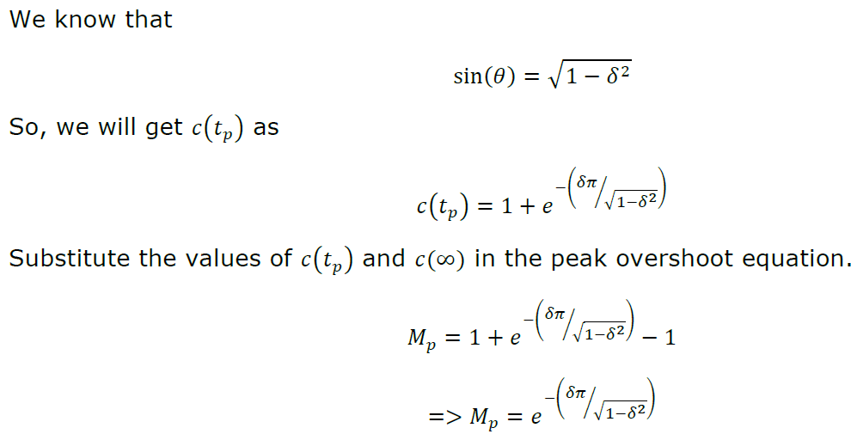

Slide 28
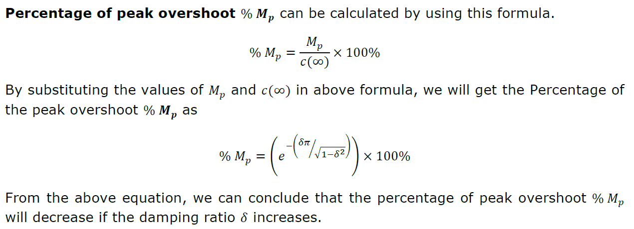

Slide 29
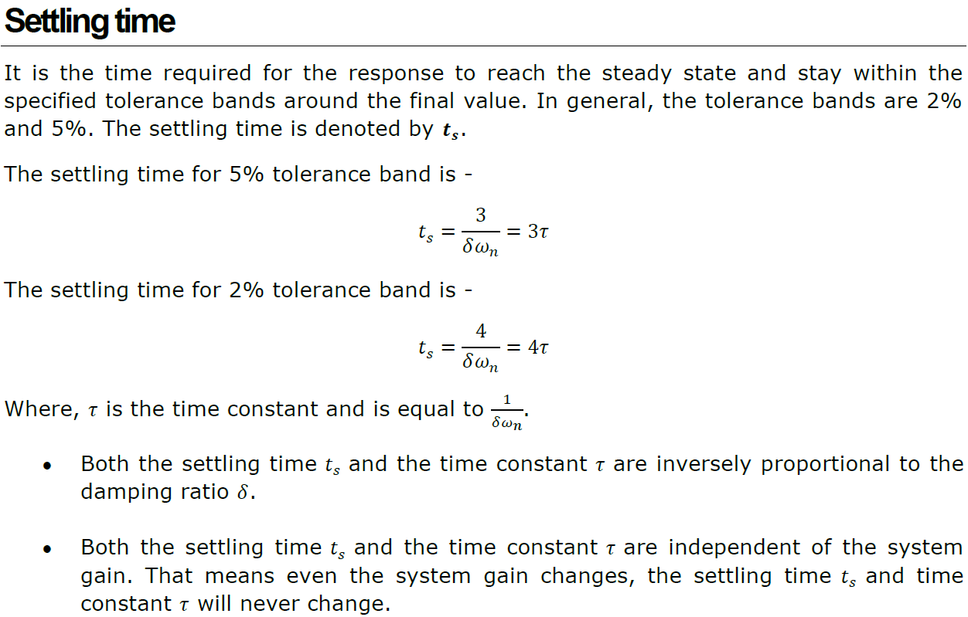

Slide 30
